Slide 1
An Introduction to Matlab
Fall 2018
Instructor: Dr. Bo-Wen Shen*
RA for Symbolic Computing: Mr. Jialin Cui
* sdsu.math252.shen@gmail.com
cjl742952519@gmail.com
Department of Mathematics and Statistics
San Diego State University

Slide 2
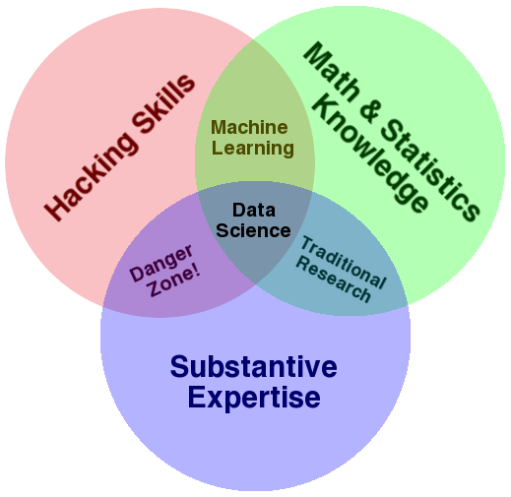
THE DATA SCIENCE VENN DIAGRAM
Variety
Velocity
Volume
Value
http://drewconway.com/zia/2013/3/26/the-data-science-venn-diagram

Slide 3
A 10 minutes Introduction to Matlab
MatLab is a powerful software created by MathWorks, which is used extensively in mathematics, engineering, and the sciences.
MatLab stands for Matrix Laboratory.
Three key capabilities are
Computing
Visualizations (or Graphics)
Symbolic computation (or computer algebra)
➔ Symbolic plotting (to get plots for symbolic functions)
References:
http://www-rohan.sdsu.edu/~jmahaffy/courses/f15/math337/Lectures.html
http://www-rohan.sdsu.edu/~jmahaffy/courses/f15/math337/beamer/matlab/basic_matlab.pdf
http://www.mathworks.com/help/pdf_doc/matlab/getstart.pdf
http://www.maths.dundee.ac.uk/ftp/na-reports/MatlabNotes.pdf
http://www.mathworks.com/academia/student_center/tutorials/launchpad.html

Slide 4
Matlab and Mathematical Software
Many forms of general-purpose numerical software are available commercially and in the public domain. Most of the early software was written for mainframe computers. Now that personal computers are sufficiently powerful, standard numerical software is available for them. Most of this numerical software is written in FORTRAN, although some packages are written in C, C++, and FORTRAN90.
ALGOL procedures were presented for matrix computations in 1971 in [WR]. A package of FORTRAN subroutines based mainly on the ALGOL procedures was then developed into the EISPACK routines.
LINPACK is a package of FORTRAN subroutines for analyzing and solving systems of linear equations and solving linear least squares problems.
MATLAB was originally written to provide easy access to matrix software developed in the LINPACK and EISPACK projects. The first version was written in the late 1970s for use in courses in matrix theory, linear algebra, and numerical analysis. There are currently more than 500,000 users of MATLAB in more than 100 countries.
In addition to Matlab, Maple (developed in 1980) and Mathematica (released in 1988) are equally popular.
References:
Burden, R., D. Faires and A. Burden, 2015: Numerical Analysis. Cengage Learning. 912pp. 10th ed. Jan. 2015.

Slide 5

Symbolic Computation: Differential and Integral Calculus
syms x %In Symbolic Math Toolbox™, symbolic variables are complex variables by default.
y=x^5
diff (y, x)
5*x^4
========================================
syms x n real #assumption
y=x^n
diff (y, x)
➔ ans =
n*x^(n - 1)
========================================
assume (n>0)
int(y,x)
➔ ans =
x^(n + 1)/(n + 1)

Slide 6
Symbolic Computation: the Inner Product (Section 12.3)
syms x y z #In Symbolic Math Toolbox™, symbolic variables are complex variables by default.
r=[x, y, z]
syms x0 y0 z0
r0=[x0, y0, z0]
syms a b c real #assumption
n=[a, b, c]
dot (n, r-r0)
➔ a*(x - x0) + b*(y - y0) + c*(z - z0)

Slide 7
Symbolic Computation: the Cross Product (Section 12.4)
syms p1 p2 p3 real %In Symbolic Math Toolbox™, symbolic variables are complex variables by default.
P=[p1, p2, p3]
syms q1 q2 q3 real
Q =[q1, q2, q3]
syms r1 r2 r3 real
R =[r1, r2, r3]
n=cross(Q-P, R-P) %PQ x PR
dot (n, r-r0)
((p2 - q2)*(p3 - r3) - (p3 - q3)*(p2 - r2))*(x - x0) - ((p1 - q1)*(p3 - r3) - (p3 - q3)*(p1 - r1))*(y - y0) + ((p1 - q1)*(p2 - r2) - (p2 - q2)*(p1 - r1))*(z - z0)
syms x y z real
X=[x, y, z]
planefunction = dot (n, X-P) %PX*n

Slide 8
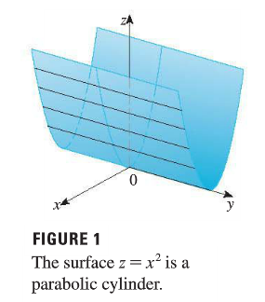
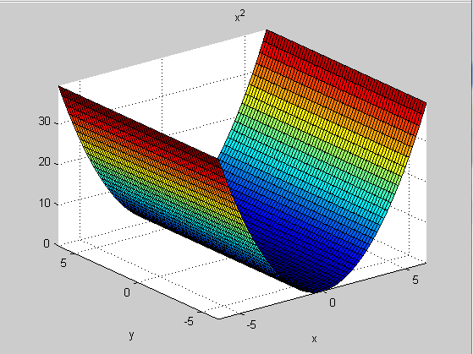
Section 12.6: Cylinders and Quadric Surface using ezsurf of MatLab
A cylinder is a surface that consists of all lines (called rulings) that are parallel to a given line and pass through a given plane curve.
A quadric surface is the graph of a second-degree equation in three variables (x, y, z).
Easy-to-use 3-D colored surface plotter
ezsurf(fun)
ezsurf(funx,funy,funz)
ezsurf(...,'circ')
The rulings of the cylinder are parallel to the y-axis.

Slide 9
Section 12.6: Cylinders and Quadric Surface using ezsurf of MatLab
Easy-to-use 3-D colored surface plotter
ezsurf(fun)
ezsurf(funx,funy,funz)
ezsurf(...,'circ')
syms x y z
ezsurf(x^2)
The rulings of the cylinder are parallel to the y-axis.

Slide 10
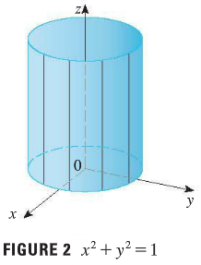
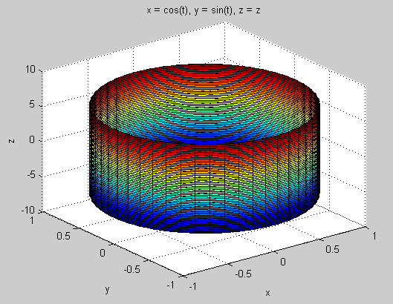
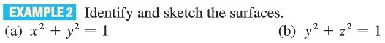
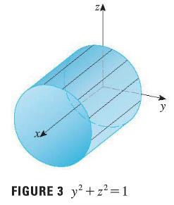
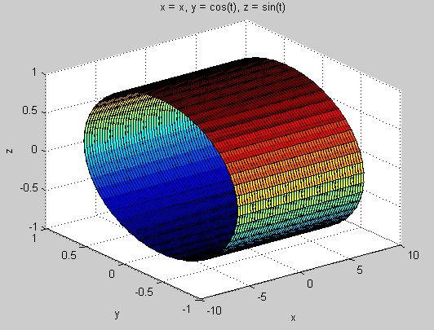
Section 12.6: Surface plots
syms x y z
ezsurf(x^2)
syms t
x=cos(t)
y=sin(t)
ezsurf(x,y,z)
syms t x y z
y=cos(t)
z=sin(t)
ezsurf(x,y,z)
parabolic cylinder
rulings: parallel to the y-axis
axis: the z-axis
rulings: vertical lines
given curve: the circle
circular cylinder
axis: the x-axis
rulings: parallel to the axis

Slide 11
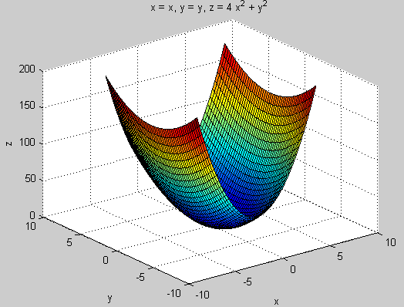
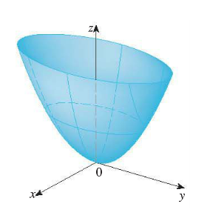
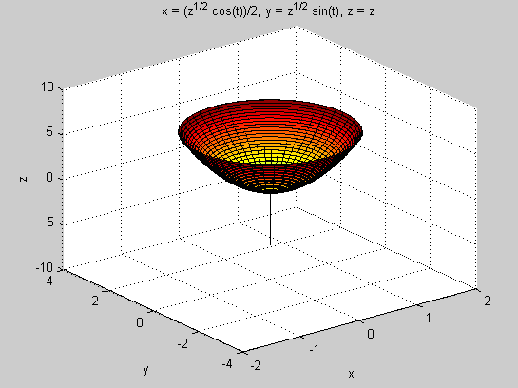
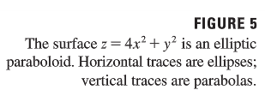
Section 12.6: Surface plots
syms x y z
z=4*x^2 + y^2
ezsurf(x, y, z)
syms x y z t
x=sqrt(z)/2*cos(t)
y=sqrt(z)*sin(t)
ezsurf(x,y,z)
elliptic paraboloid

Slide 12
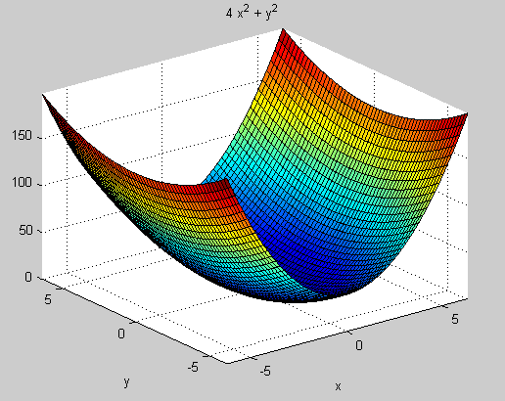
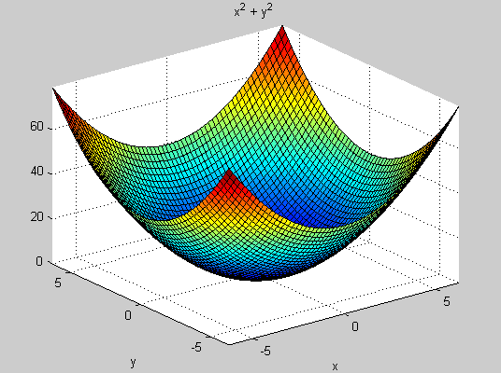
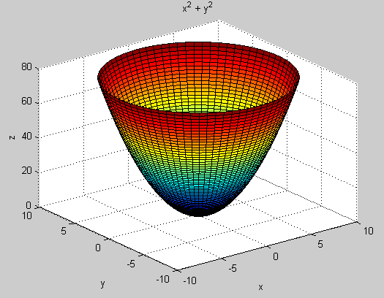
Section 12.6: Surface plots
(left, top)
syms x y z
z=4*x^2 + y^2
ezsurf(x, y, z)
syms x y z
ezsurf(4*x^2 + y^2)
(left, bottom)
syms x y z
ezsurf(x^2 + y^2)
(right, bottom)
syms x y z
ezsurf(x^2+y^2, 'circ')
%ezsurf(...,'circ') plots fun (“function”) over a disk centered on the domain.

Slide 13
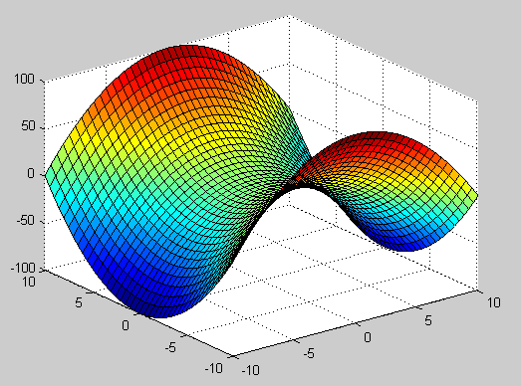
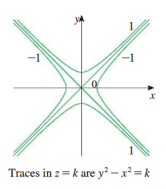
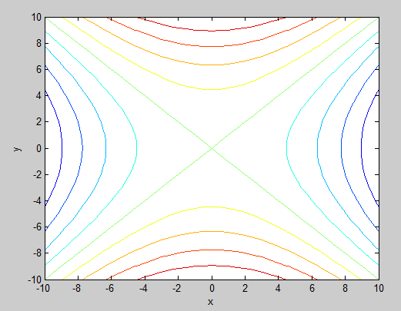
Section 12.6: Surface plots
syms x y z
ezsurf(y^2-x^2)
hyperbolic paraboloid
%Hyperbolic paraboloid
x = [-10:.5:10]; y=[-10:.5:10];
[X, Y] = meshgrid(x,y);
Z = Y.^2-X.^2;
surf(X,Y,Z)
contour(X,Y,Z)
xlabel x
ylabel y
zlabel z

Slide 14
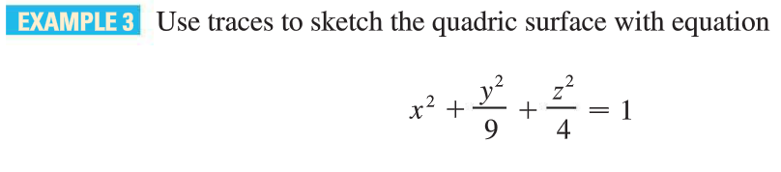
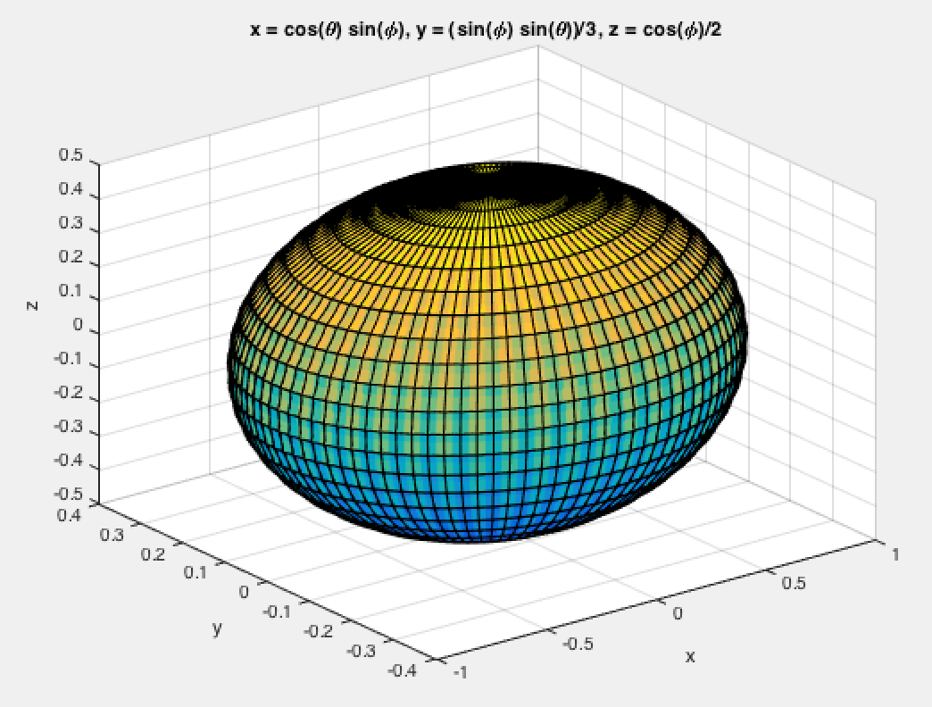
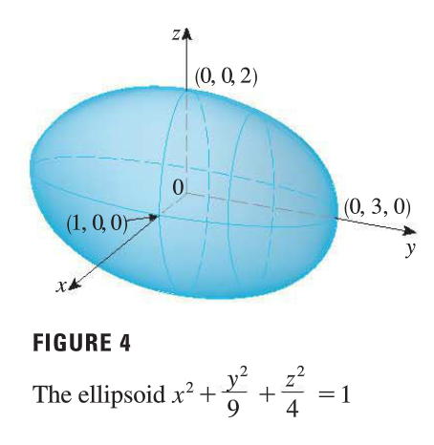
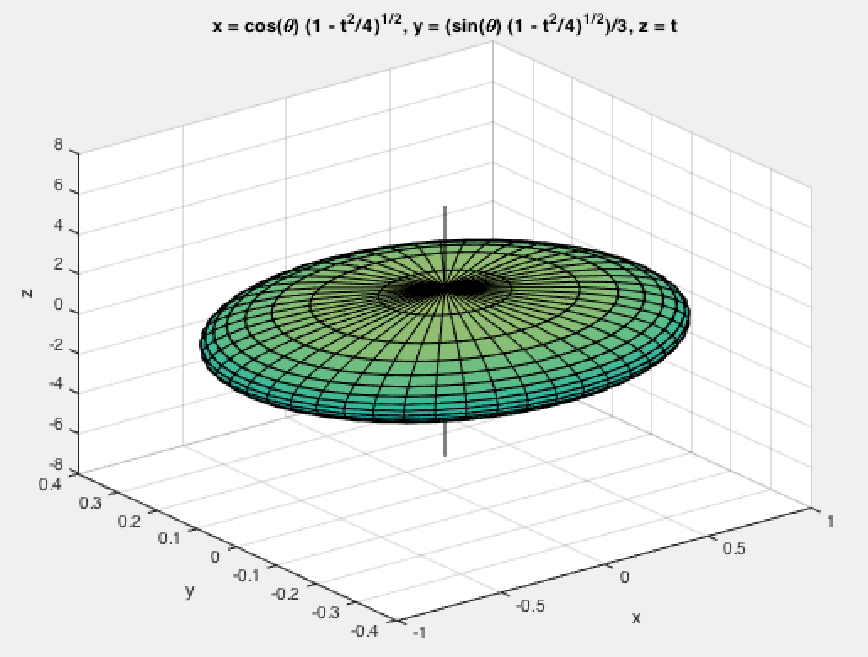
Section 12.6: Surface plots
syms x y z phi theta real
x=sin(phi)*cos(theta)
y=1/3*sin(phi)*sin(theta)
z=1/2*cos(phi)
ezsurf(x, y, z)
ellipsoid
syms x y z t theta
z=t
x=sqrt(1-t^2/4)*cos(theta)
y=1/3*sqrt(1-t^2/4)*sin(theta)
ezsurf(x, y, z)

Slide 15
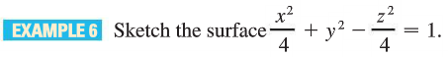
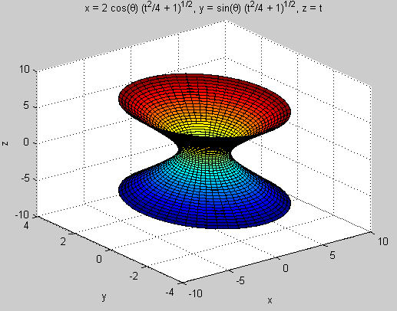
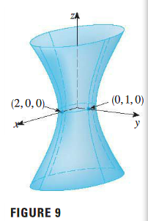
Section 12.6: Surface plots
syms x y z t theta
z=t
x=2*sqrt(1+t^2/4)*cos(theta)
y=sqrt(1+t^2/4)*sin(theta)
ezsurf(x, y, z)
Hyperboloid of One Sheet

Slide 16
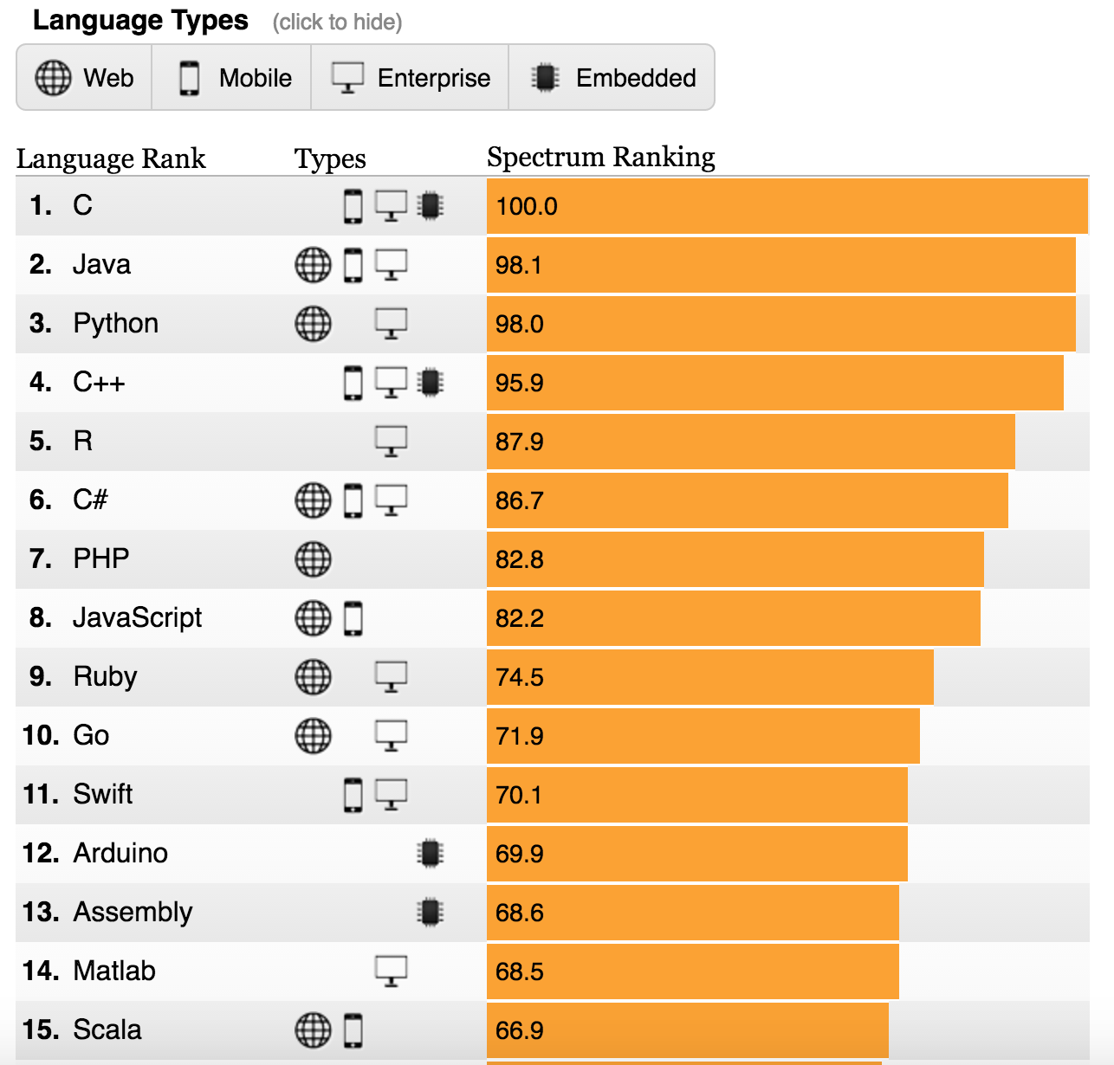
The Top Programming Languages 2016
IEEE Spectrum
Enterprise

Slide 17
Python Facts
Python is an open-source, high-level, OOP scripting languages;
Python Is a widely used, general-purpose, interpreted language;
Python is similar to MATLAB;
Python is recommended by the Raspberry Pi Foundation

Slide 18
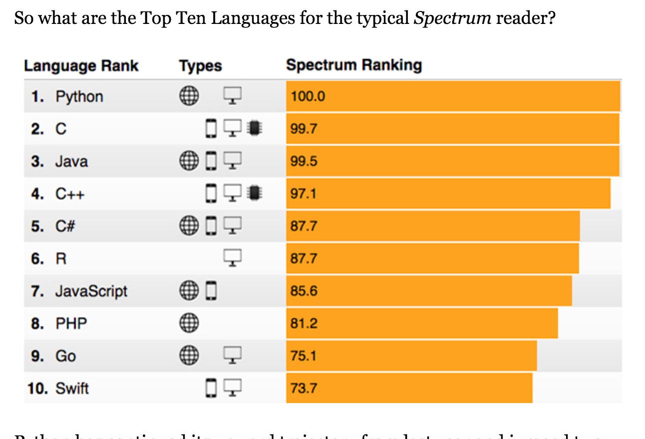
The Top Programming Languages 2017

Slide 19
Python Facts
Python is often used for
symbolic computation,
scientific computing and plotting,
multi-tasking (i.e., fork),
multi-threading,
network programming (TCP/IP, IPC),
MPI parallel computing,
web development, and
game programming.

Slide 20
Symbolic Computation in Python
from sympy import *
x,y,z=symbols("x y z")
y=x**6
#y=x^5, error
ans1=diff(y,x)
print(ans1)
→ 6*x**5
#
#
ans2=integrate(y,x)
print(ans2)
→ x**7/7
#
simplify(ans2)
#
from sympy import *
x,y,z, n=symbols("x y z n")
y=x**n
#y=x^5, error
ans1=diff(y,x)
print(ans1)
→ n*x**n/x
#
#
ans2=integrate(y,x)
print(ans2)
→ Piecewise((log(x), n == -1), (x**(n + 1)/(n + 1), True))
#
simplify(ans2)
#

Slide 21
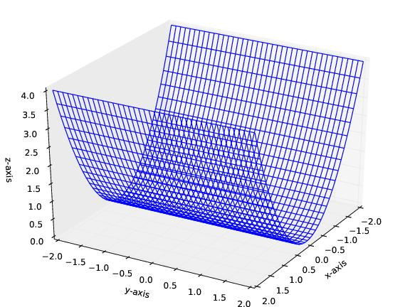
Ex1 in Python
from mpl_toolkits.mplot3d import axes3d
import matplotlib.pyplot as plt
import numpy as np
fig=plt.figure()
ax=axes3d.Axes3D(fig,azim=30,elev=30)
x=np.linspace(-2,2,40)
y=np.linspace(-2,2,40)
X, Y=np.meshgrid(x,y)
Z=X**2
ax.plot_wireframe(X,Y,Z)
ax.set_xlabel('x-axis')
ax.set_ylabel('y-axis')
ax.set_zlabel('z-axis')
plt.savefig('ex1.ps')
plt.show()

Slide 22
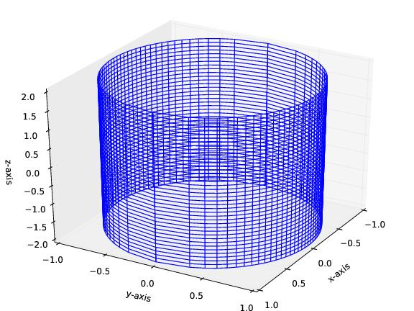
Ex2 in Python
from mpl_toolkits.mplot3d import axes3d
import matplotlib.pyplot as plt
import numpy as np
fig=plt.figure()
ax=axes3d.Axes3D(fig,azim=30,elev=30)
x=np.linspace(-1,1,40)
z=np.linspace(-2,2,40)
X, Z=np.meshgrid(x,z)
Y=np.sqrt(1-X**2)
ax.plot_wireframe(X,Y,Z)
ax.plot_wireframe(X,-Y,Z)
ax.set_xlabel('x-axis')
ax.set_ylabel('y-axis')
ax.set_zlabel('z-axis')
plt.savefig('ex2.ps')
plt.show()

Slide 23
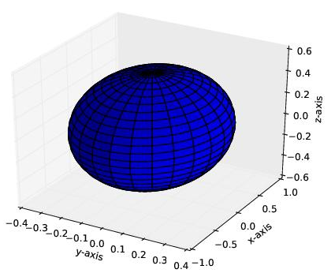
Ex3 in Python
from mpl_toolkits.mplot3d import Axes3D
import matplotlib.pyplot as plt
import numpy as np
fig = plt.figure()
ax = fig.add_subplot(111, projection='3d')
u = np.linspace(0, 2 * np.pi, 100) #theta
v = np.linspace(0, np.pi, 100) #phi
x = 1. * np.outer(np.cos(u), np.sin(v)) #outer:
y = 1./3. * np.outer(np.sin(u), np.sin(v))
z = 1./2. * np.outer(np.ones(np.size(u)), np.cos(v))
#ax.plot_surface(x, y, z, rstride=4, cstride=4, color='b')
ax.plot_surface(y, x, z, rstride=4, cstride=4, color='b')
ax.set_xlabel('y-axis')
ax.set_ylabel('x-axis')
ax.set_zlabel('z-axis')
plt.savefig('ex3.ps')
plt.show()

Slide 24
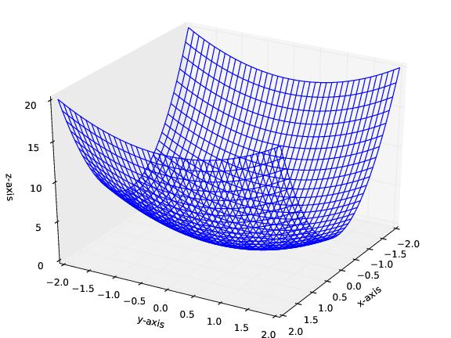
Ex4 in Python
from mpl_toolkits.mplot3d import axes3d
import matplotlib.pyplot as plt
import numpy as np
fig=plt.figure()
ax=axes3d.Axes3D(fig,azim=30,elev=30)
x=np.linspace(-2,2,40)
y=np.linspace(-2,2,40)
X, Y=np.meshgrid(x,y)
Z=4*X**2 + Y**2
ax.plot_wireframe(X,Y,Z)
ax.set_xlabel('x-axis')
ax.set_ylabel('y-axis')
ax.set_zlabel('z-axis')
plt.savefig('ex4.ps')
plt.show()

Slide 25
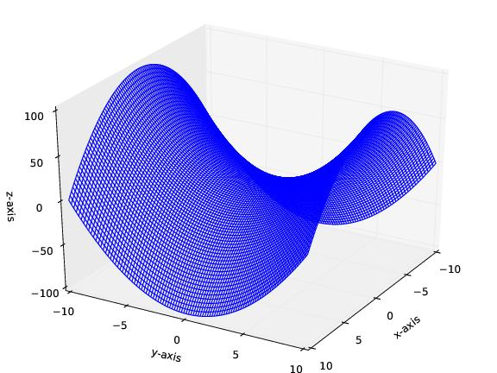
Ex5 in Python
from mpl_toolkits.mplot3d import axes3d
import matplotlib.pyplot as plt
import numpy as np
fig=plt.figure()
ax=axes3d.Axes3D(fig,azim=30,elev=30)
x=np.linspace(-10,10,100)
y=np.linspace(-10,10,100)
X, Y=np.meshgrid(x,y)
Z= Y**2 - X**2
ax.plot_wireframe(X,Y,Z)
ax.set_xlabel('x-axis')
ax.set_ylabel('y-axis')
ax.set_zlabel('z-axis')
plt.savefig('ex5.ps')
plt.show()

Slide 26
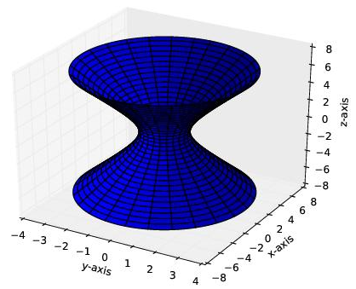
Ex6 in Python
from mpl_toolkits.mplot3d import Axes3D
import matplotlib.pyplot as plt
import numpy as np
fig = plt.figure()
ax = fig.add_subplot(111, projection='3d')
u = np.linspace(0, 2 * np.pi, 100) #theta
t = np.linspace(-7, 7, 140) #t
x = 2. * np.outer(np.cos(u), np.sqrt(1+t**2/4))
y = 1. * np.outer(np.sin(u), np.sqrt(1+t**2/4))
z = 1. * np.outer(np.ones(np.size(u)), t)
ax.plot_surface(y, x, z, rstride=4, cstride=4, color='b')
#ax.plot_surface(x, y, z, rstride=4, cstride=4, color='b')
ax.set_xlabel('y-axis')
ax.set_ylabel('x-axis')
ax.set_zlabel('z-axis')
plt.savefig('ex6.ps')
plt.show()

Slide 27
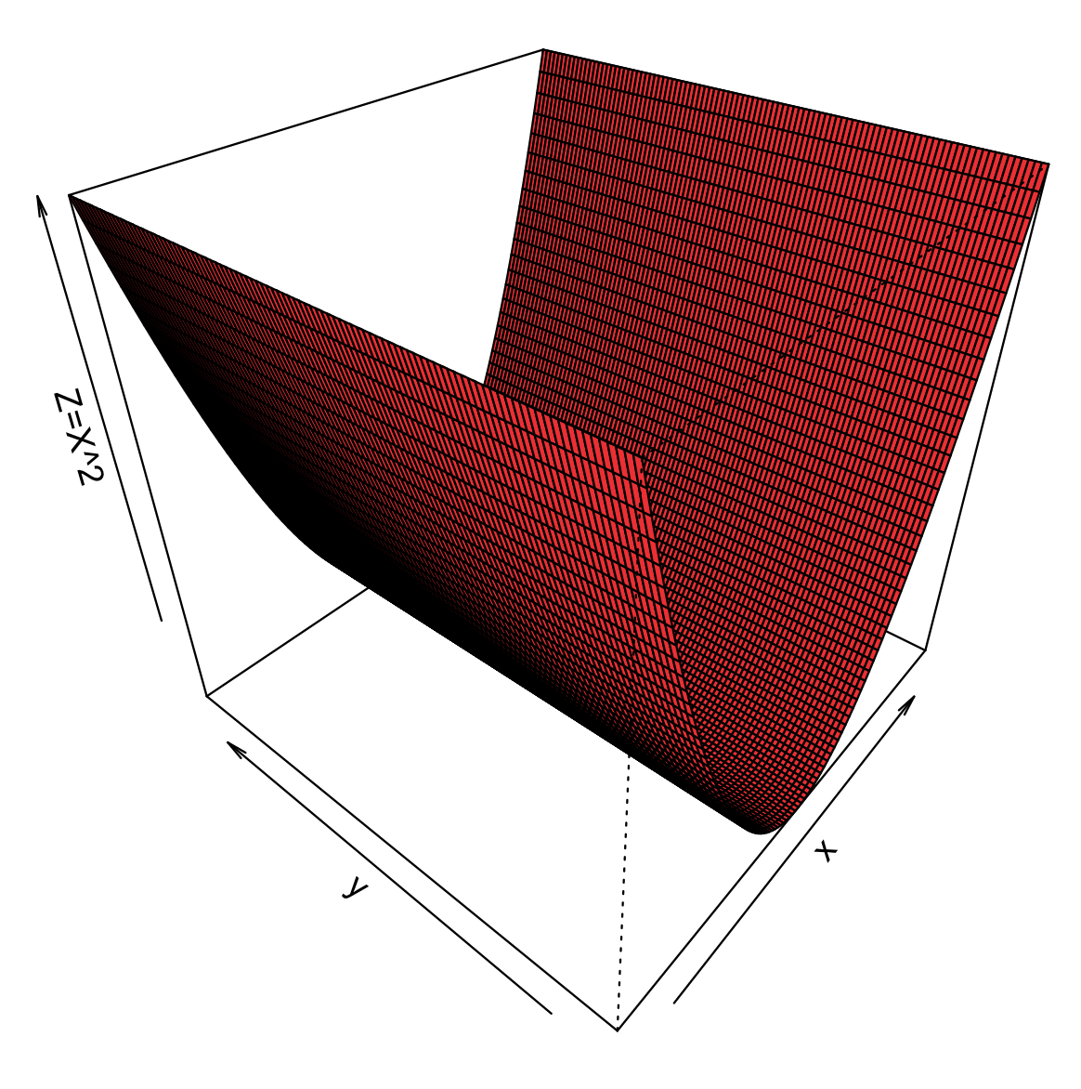
Ex1 in R
library(package = "TDA")
x=seq(-5, 5, length=100)
y=seq(-5, 5, length=100)
z=outer(x,y, function(x,y) {x^2})
persp(x,y,z, xlab='x', ylab='y', zlab="Z=X^2", theta=-50, phi=35, col='firebrick2')
dev.copy2pdf(file="ex1.pdf")
png("ex1.png")

Slide 28
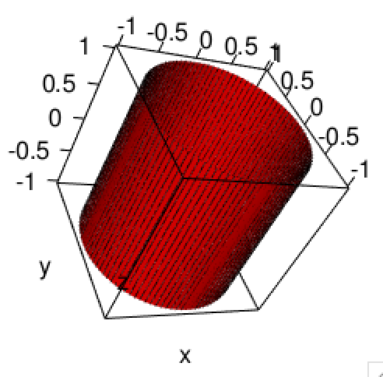
Ex2 in R
library(package = "TDA")
library("rgl")
u = seq(0, 2 * pi, length=100) #theta
ones = array(1, dim=length(u))
t = seq(-1, 1, length=100) #phi
ones_t = array(1, dim=length(v))
x = 1. * outer(cos(u), ones_t) #outer:
y = 1. * outer(sin(u), ones_t)
z = 1. * outer(ones, t)
plot3d(x, y, z,
xlab="x",ylab="y",zlab="z", type="s", xlim=c(-1,1), ylim=c(-1,1), size=0.25, aspect=FALSE)
surface3d(x,y,z, color='red')
dev.copy2pdf(file="ex2.pdf")
png("ex2.png")

Slide 29
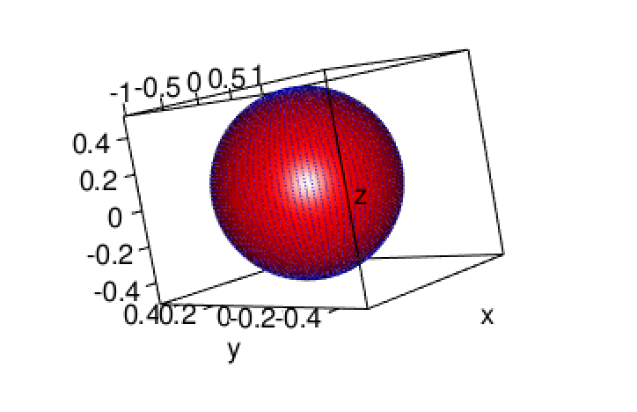
Ex3 in R
library(package = "TDA")
library("rgl")
u = seq(0, 2 * pi, length=100) #theta
ones = array(1, dim=length(u))
v = seq(0, pi, length=100) #phi
x = 1. * outer(cos(u), sin(v)) #outer:
y = 1./3. * outer(sin(u), sin(v))
z = 1./2. * outer(ones, cos(v))
plot3d(x, y, z,
xlab="x",ylab="y",zlab="z", type="s", xlim=c(-1,1), ylim=c(-0.5,0.5), col = "blue", size=0.25, aspect=FALSE)
surface3d(x,y,z, color='red')
dev.copy2pdf(file="ex3.pdf")
png("ex3.png")

Slide 30
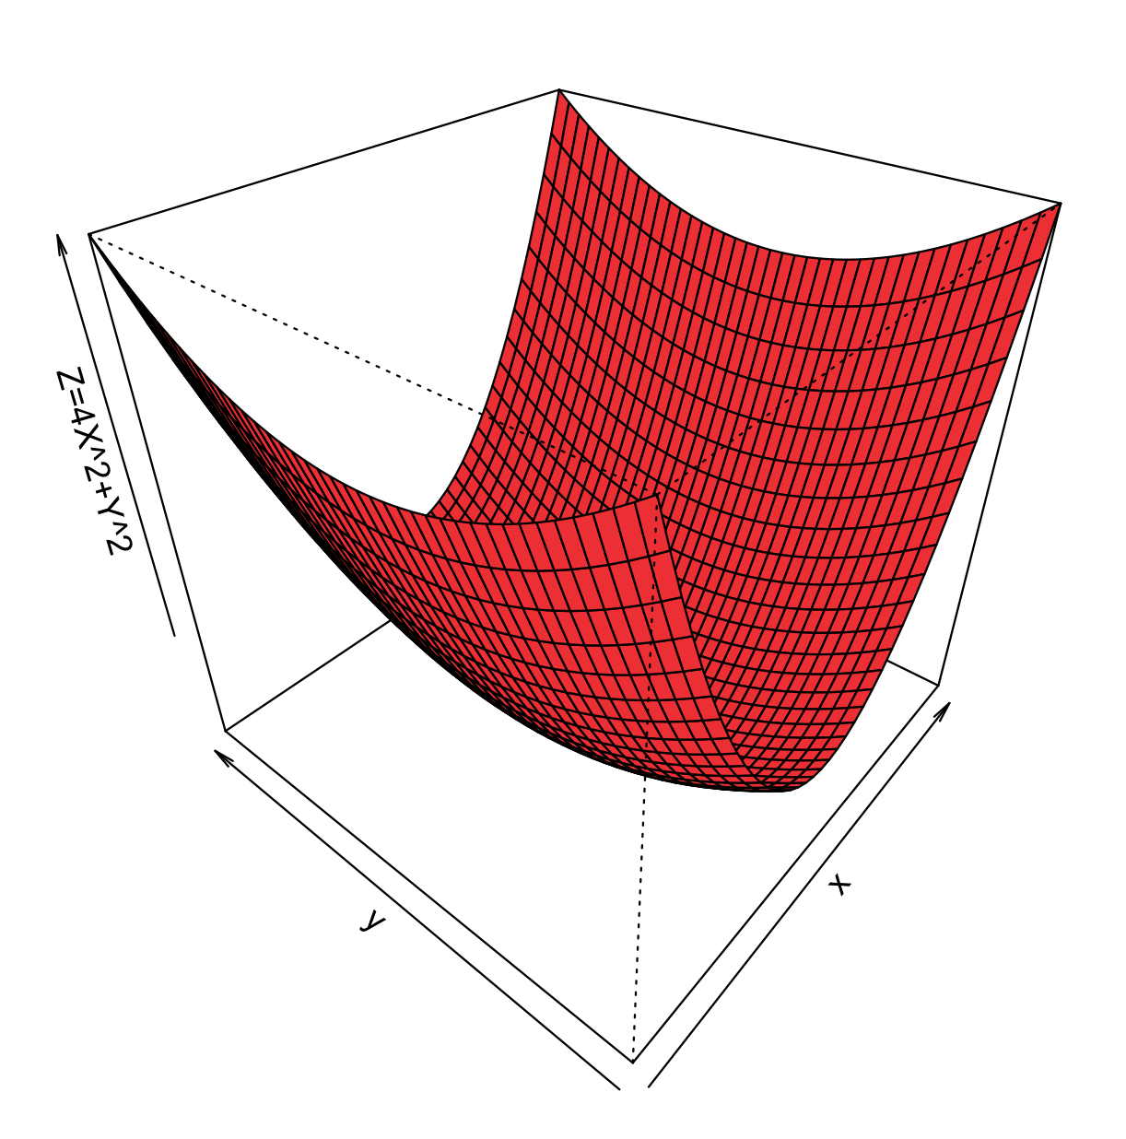
Ex4 in R
library(package = "TDA")
x=seq(-2, 2, length=40)
y=seq(-2, 2, length=40)
z=outer(x,y, function(x,y) {4*x^2+y^2})
persp(x,y,z, xlab='x', ylab='y', zlab="Z=4X^2+Y^2", theta=-50, phi=35, col='firebrick2')
dev.copy2pdf(file="ex4.pdf")
png("ex4.png")

Slide 31
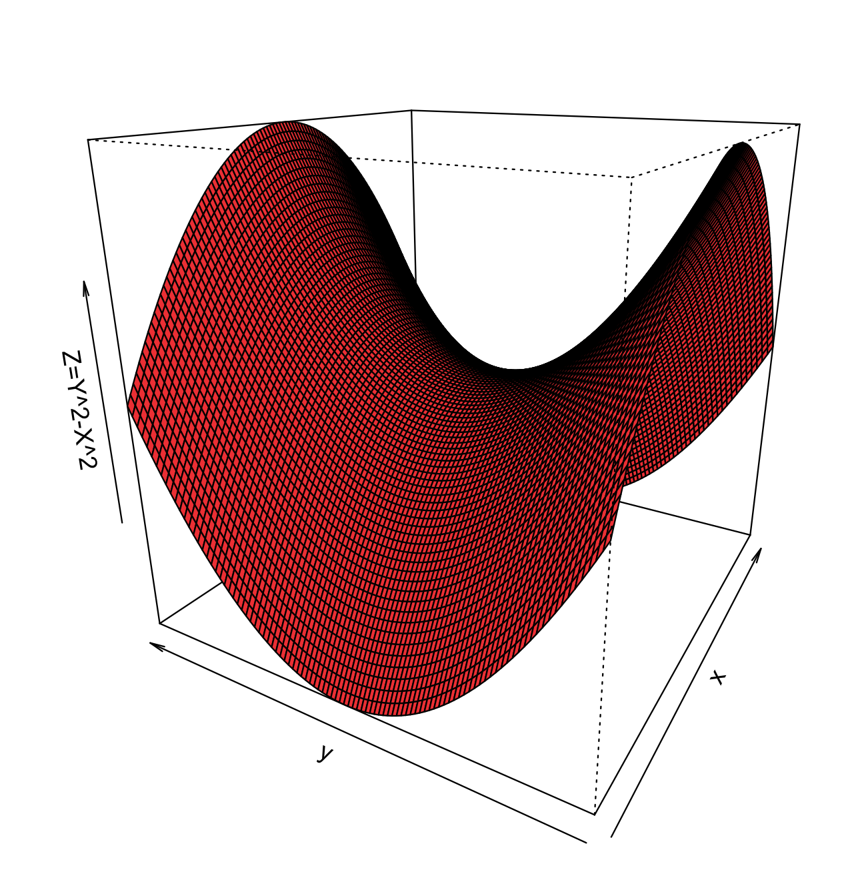
Ex5 in R
library(package = "TDA")
x=seq(-10, 10, length=100)
y=seq(-10, 10, length=100)
z=outer(x,y, function(x,y) {y^2-x^2})
persp(x,y,z, xlab='x', ylab='y', zlab="Z=Y^2-X^2", theta=-60, phi=20, col='firebrick2')
dev.copy2pdf(file="ex5.pdf")
png("ex5.png")

Slide 32
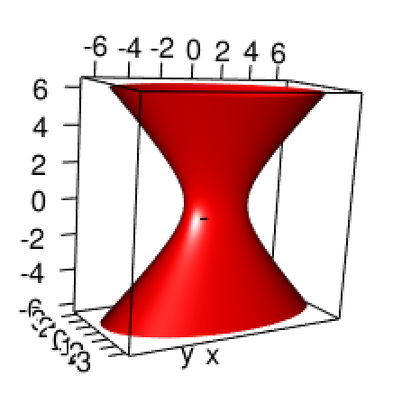
Ex6 in R
library(package = "TDA")
library("rgl")
u = seq(0, 2 * pi, length=100) #theta
ones = array(1, dim=length(u))
t = seq(-2*pi, 2*pi, length=100) #phi
x = 2. * outer(cos(u), sqrt(1+t^2/4)) #outer:
y = 1. * outer(sin(u), sqrt(1+t^2/4))
z = 1. * outer(ones, t)
plot3d(x, y, z,
xlab="x",ylab="y",zlab="z", type="s", xlim=c(-1,1), ylim=c(-0.5,0.5), col = "blue", size=0.25, aspect=FALSE)
surface3d(x,y,z, color='red')
dev.copy2pdf(file="ex6.pdf")
png("ex6.png")

Slide 33
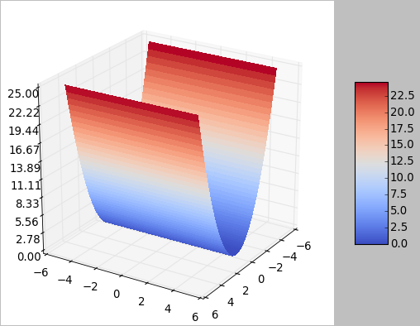
Ex1 in Julia
using PyPlot
using QuantEcon
fig = figure()
x = linspace(-5, 5, 100)
y = linspace(-5, 5, 100)
X, Y = meshgrid(collect(x), collect(y))
Z = X.^2
#surf = plot_surface(X, Y, Z, rstride=1, cstride=1, linewidth=0, antialiased=false, cmap="coolwarm")
surf = plot_surface(x, y, Z, rstride=1, cstride=1, linewidth=0, antialiased=false, cmap="coolwarm")
#zlim(-1.01,1.01)
ax = gca()
ax[:zaxis][:set_major_locator](matplotlib[:ticker][:LinearLocator](10))
ax[:zaxis][:set_major_formatter](matplotlib[:ticker][:FormatStrFormatter]("%.02f"))
fig[:colorbar](surf, shrink=0.5, aspect=5)
savefig("ex1.pdf")

Slide 34
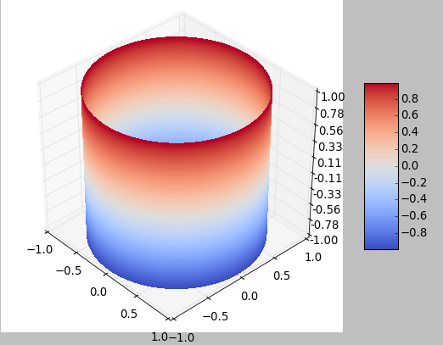
Ex2 in Julia
using PyPlot
using QuantEcon
fig = figure()
n=100
u = linspace(0, 2pi, n) #theta
v = linspace(-1, 1, n)
x = Array(Float64, n, n)
y = Array(Float64, n, n)
z = Array(Float64, n, n)
xf(xx, yy) = cos(xx)
yf(xx, yy) = sin(xx)
zf(xx, yy) = yy
for i in 1:n
for j in 1:n
x[j, i] = xf(u[i], v[j])
y[j, i] = yf(u[i], v[j])
z[j,i] = zf(u[i], v[j])
end
end
surf = plot_surface(x, y, z, rstride=1, cstride=1, linewidth=0, antialiased=false, cmap="coolwarm”)
ax = gca()
ax[:zaxis][:set_major_locator](matplotlib[:ticker][:LinearLocator](10))
ax[:zaxis][:set_major_formatter](matplotlib[:ticker][:FormatStrFormatter]("%.02f"))
fig[:colorbar](surf, shrink=0.5, aspect=5)
savefig("ex2.pdf")

Slide 35
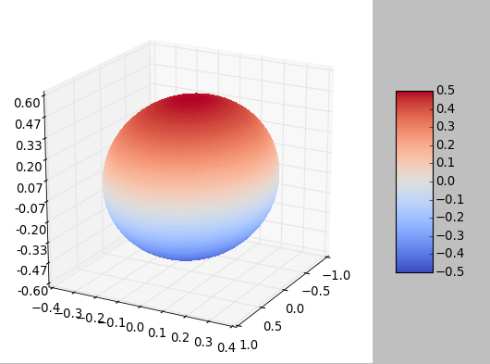
Ex3 in Julia
using PyPlot
using QuantEcon
fig = figure()
n=100
u = linspace(0, 2pi, n) #theta
v = linspace(0, pi, n) #phi
x = Array(Float64, n, n)
y = Array(Float64, n, n)
z = Array(Float64, n, n)
xf(xx, yy) = cos(xx)*sin(yy)
yf(xx, yy) = 1.0/3.0*sin(xx)*sin(yy)
zf(xx, yy) = 1.0/2.0*cos(yy)
for i in 1:n
for j in 1:n
x[j, i] = xf(u[i], v[j])
y[j, i] = yf(u[i], v[j])
z[j,i] = zf(u[i], v[j])
end
end
surf = plot_surface(x, y, z, rstride=1, cstride=1, linewidth=0, antialiased=false, cmap="coolwarm")
#zlim(-1.01,1.01)
ax = gca()
ax[:zaxis][:set_major_locator](matplotlib[:ticker][:LinearLocator](10))
ax[:zaxis][:set_major_formatter](matplotlib[:ticker][:FormatStrFormatter]("%.02f"))
fig[:colorbar](surf, shrink=0.5, aspect=5)
savefig("ex3.pdf")

Slide 36
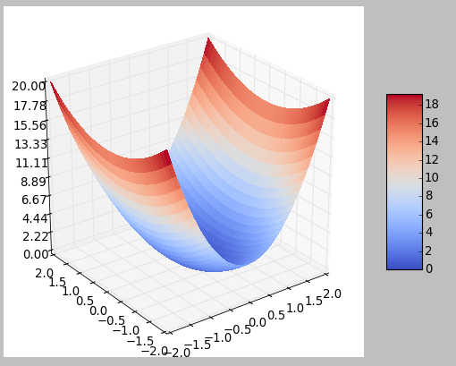
Ex4 in Julia
using PyPlot
#using QuantEcon: meshgrid
using QuantEcon
fig = figure()
#x = linspace(-5, 5, 100)'
n = 40
x = linspace(-2, 2, n)
y = linspace(-2, 2, n)
X, Y = meshgrid(collect(x), collect(y))
Z = 4 * X.^2 + Y.^2
surf = plot_surface(x, y, Z, rstride=1, cstride=1, linewidth=0, antialiased=false, cmap="coolwarm")
#zlim(-1.01,1.01)
ax = gca()
ax[:zaxis][:set_major_locator](matplotlib[:ticker][:LinearLocator](10))
ax[:zaxis][:set_major_formatter](matplotlib[:ticker][:FormatStrFormatter]("%.02f"))
fig[:colorbar](surf, shrink=0.5, aspect=5)
savefig("ex4.pdf")

Slide 37
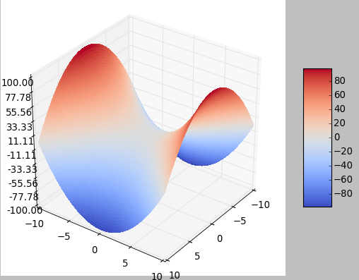
Ex5 in Julia
using PyPlot
#using QuantEcon: meshgrid
using QuantEcon
fig = figure()
#x = linspace(-5, 5, 100)'
n = 100
x = linspace(-10, 10, n)
y = linspace(-10, 10, n)
X, Y = meshgrid(collect(x), collect(y))
Z = Y.^2 - X.^2
surf = plot_surface(x, y, Z, rstride=1, cstride=1, linewidth=0, antialiased=false, cmap="coolwarm")
#zlim(-1.01,1.01)
ax = gca()
ax[:zaxis][:set_major_locator](matplotlib[:ticker][:LinearLocator](10))
ax[:zaxis][:set_major_formatter](matplotlib[:ticker][:FormatStrFormatter]("%.02f"))
fig[:colorbar](surf, shrink=0.5, aspect=5)
savefig("ex5.pdf")

Slide 38
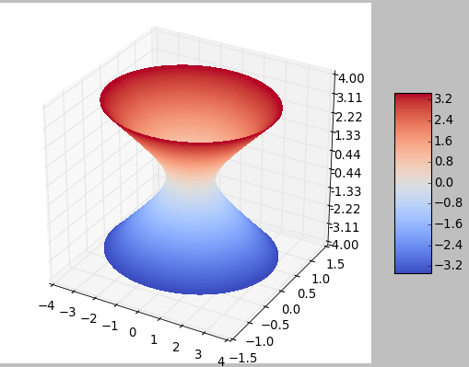
Ex6 in Julia
using PyPlot
using QuantEcon
fig = figure()
n=100
u = linspace(0, 2pi, n) #theta
#v = linspace(0, pi, n) #phi
v = linspace(-7, 7, n)
x = Array(Float64, n, n)
y = Array(Float64, n, n)
z = Array(Float64, n, n)
xf(xx, yy) = cos(xx)*sqrt(1+yy^2/4)
yf(xx, yy) = 1.0/3.0*sin(xx)*sqrt(1+yy^2/4)
zf(xx, yy) = 1.0/2.0*yy
for i in 1:n
for j in 1:n
x[j, i] = xf(u[i], v[j])
y[j, i] = yf(u[i], v[j])
z[j,i] = zf(u[i], v[j])
end
end
surf = plot_surface(x, y, z, rstride=1, cstride=1, linewidth=0, antialiased=false, cmap="coolwarm")
#zlim(-1.01,1.01)
ax = gca()
ax[:zaxis][:set_major_locator](matplotlib[:ticker][:LinearLocator](10))
ax[:zaxis][:set_major_formatter](matplotlib[:ticker][:FormatStrFormatter]("%.02f"))
fig[:colorbar](surf, shrink=0.5, aspect=5)
savefig("ex6.pdf")

Slide 39
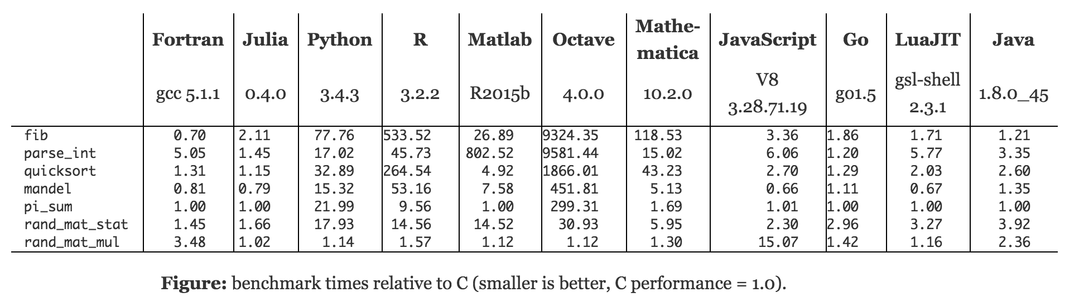
Performance

Slide 40
EX-1 Section 12.6: Surface plots
Matlab
Python
R
Julia

Slide 41
EX-2 Section 12.6: Surface plots
Matlab
Python
R
Julia

Slide 42
EX-3 Section 12.6: Surface plots
Matlab
Python
R
Julia

Slide 43
EX-4 Section 12.6: Surface plots
Matlab
Python
R
Julia

Slide 44
EX-5 Section 12.6: Surface plots
Matlab
Python
R
Julia

Slide 45
EX-6 Section 12.6: Surface plots
Matlab
Python
R
Julia

Slide 46
Performance

Slide 47
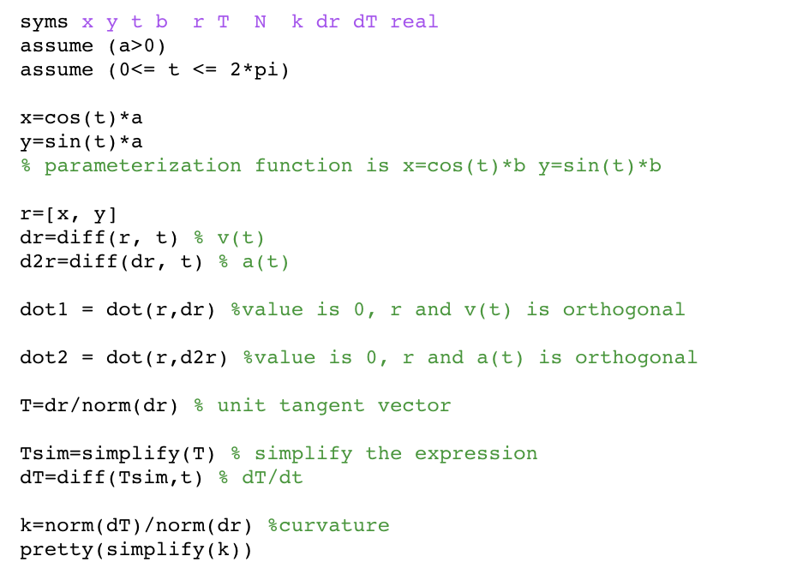
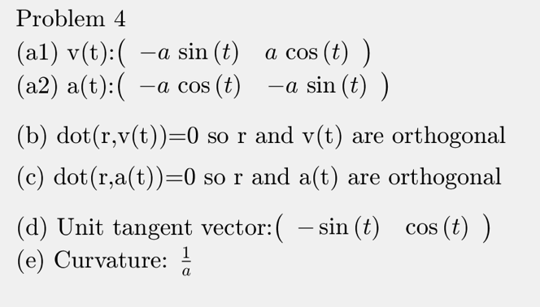
Midterm Q4

